Slide 1

Public Communication
Marketing, Media, and Civic Engagement
Joe Caterine
Web & Content Strategist
W&M’s Batten School & VIMS

Slide 2
Agenda
PART 1
PART 2
PART 3
Marketing Yourself
Media Interviews
Civic Engagement
Your brand, your audience, and how social media can help or hurt your business.
Working with journalists, handling questions, and presenting your best self.
Making your voice heard at public meetings and working with others effectively.

Slide 3
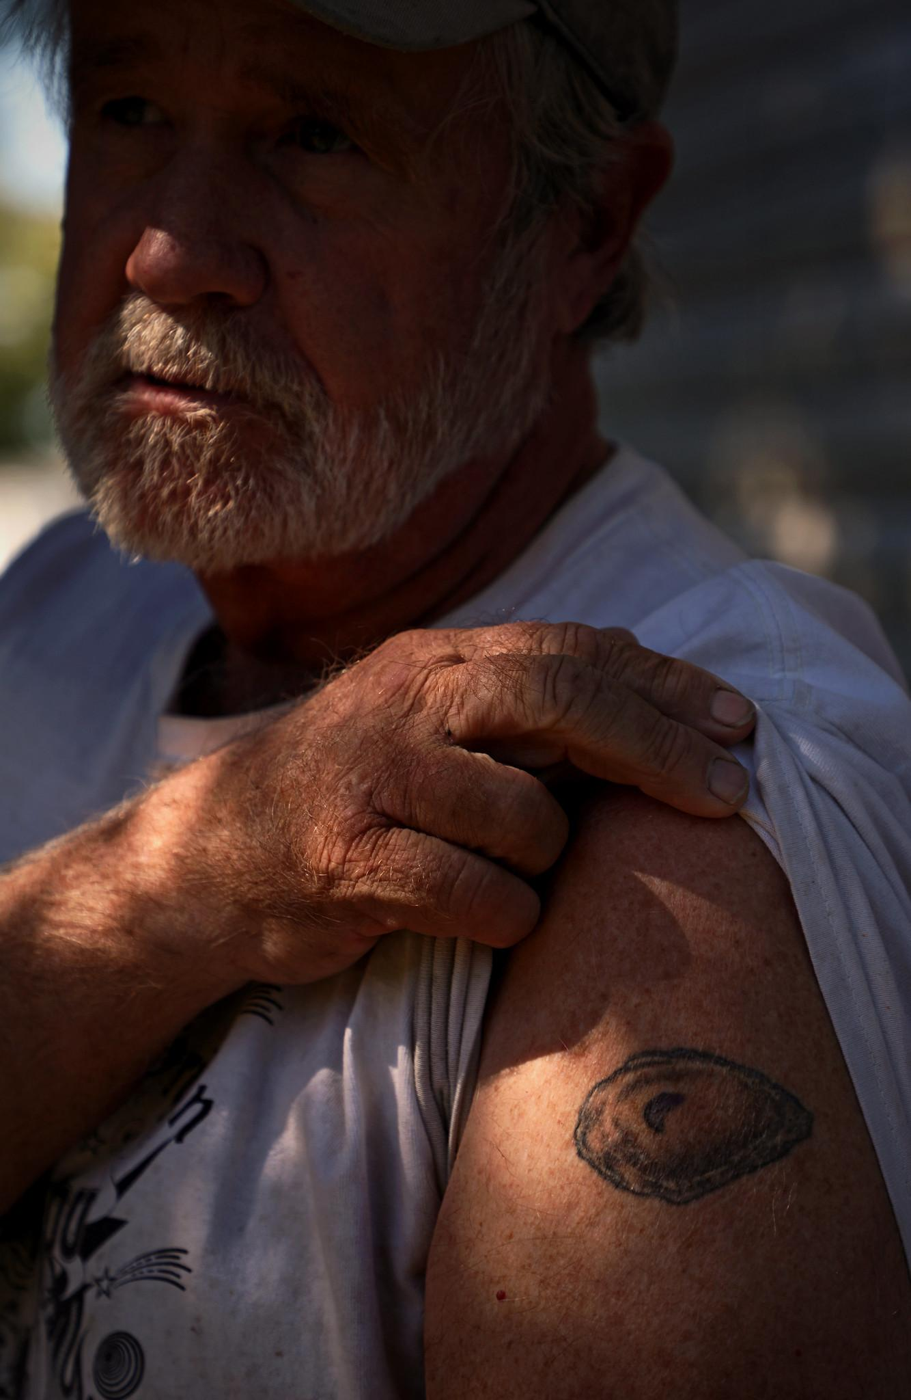
PART 1
Your Brand
What is your brand?
Your business’s reputation. How customers, restaurants, and your community see you. It's hard to build and easy to damage.
You define your brand
Everything you do, at work or not, can impact your business. It’s better to be proactive than reactive. What do you want your business to be known for?
Brand awareness
Once you understand what your business is about, how do you tell other people about it? Communication is a two-way street.
Photo credit: VA Sea Grant

Slide 4
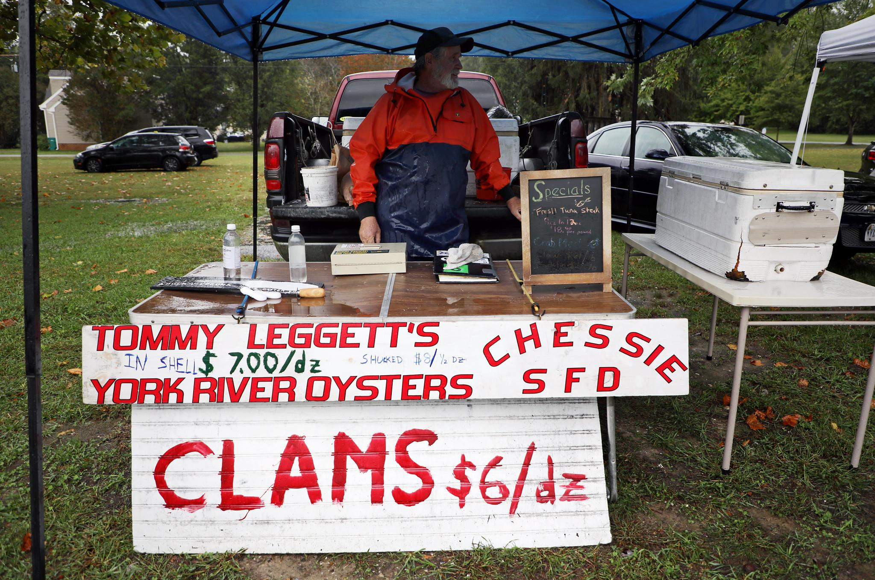
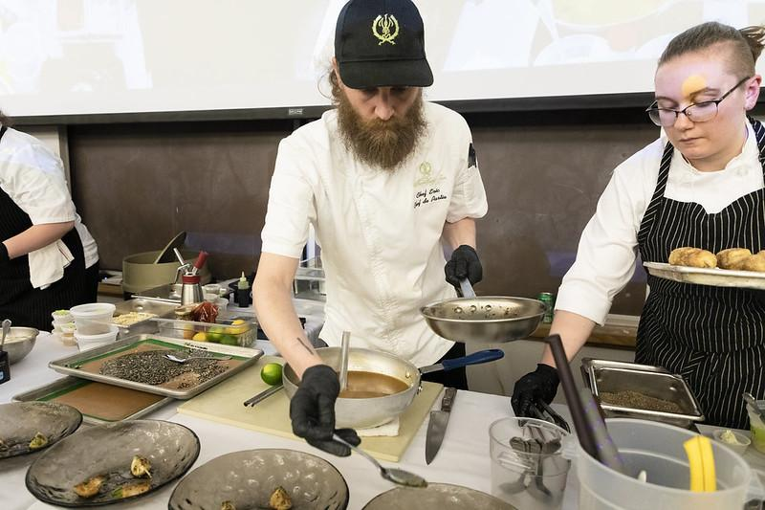
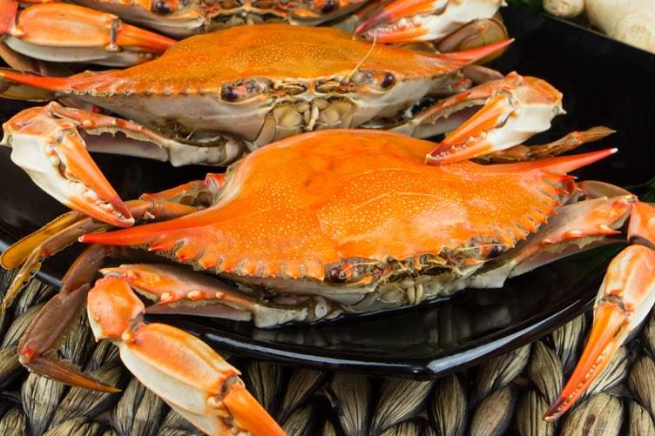
Know Your Audience
Different customers want different things.
Direct Consumers
Restaurants / Chefs
Wholesalers / Dealers

Slide 5

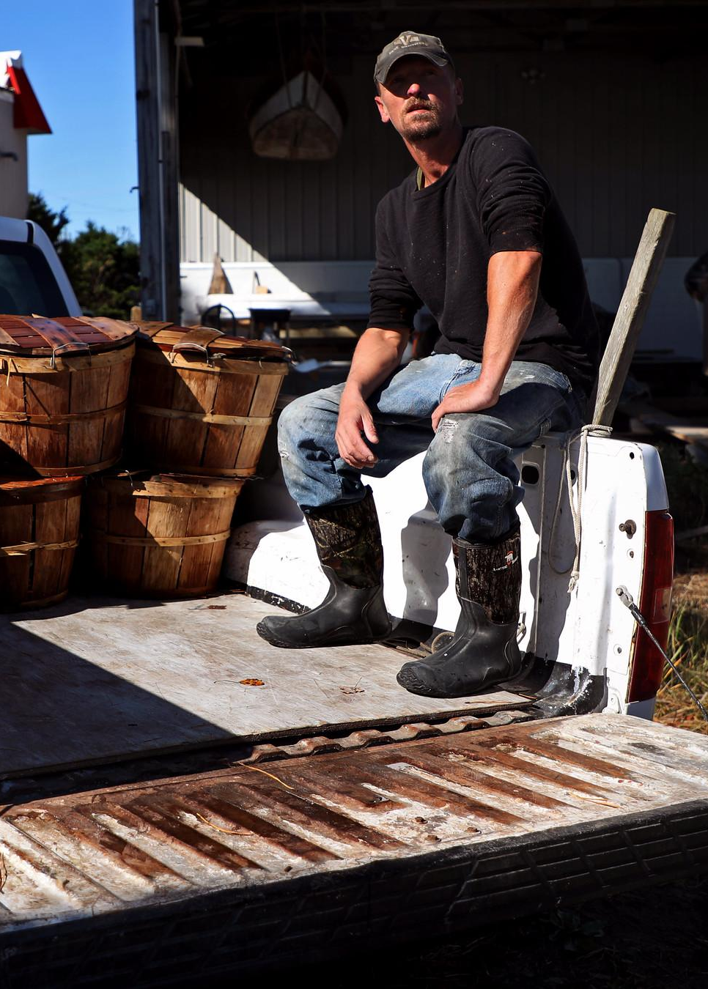
PART 2
Working with the Media
Boosting your brand
Journalists can help tell your story and promote your business. Remember, interviews are collaborations, not interrogations.
You’re in control
During a recorded interview, you can ask the reporter to repeat the question, you can decline to comment, you can pause - speak on your terms.
Share the report
Clip or copy and paste your favorite part of the report and share on your social media with your own commentary. Make it work for your business.

Slide 6
Handling Tough Questions
BROAD QUESTIONS
LOADED QUESTIONS
"What does working on the water mean to you?"
"Does fishing negatively impact…"
These can trip you up because there's no obvious answer. The trick: get specific.
Don't get defensive. Reframe the question and answer what you wish they'd asked.
Try this approach:
Try this approach:
"For me, it's about [one specific thing]. For example, [concrete story or detail]."
"That’s an interesting question. From my point of view, fishing is a personal passion that I’ve turned into a business that benefits…
Be aware of your body language
On camera, people notice crossed arms, eye contact, and nervous habits. Stand or sit comfortably, look at the reporter (not the camera), and speak naturally. Practice in front of the mirror!

Slide 7
HANDS-ON ACTIVITY
Mock Interviews

Slide 8

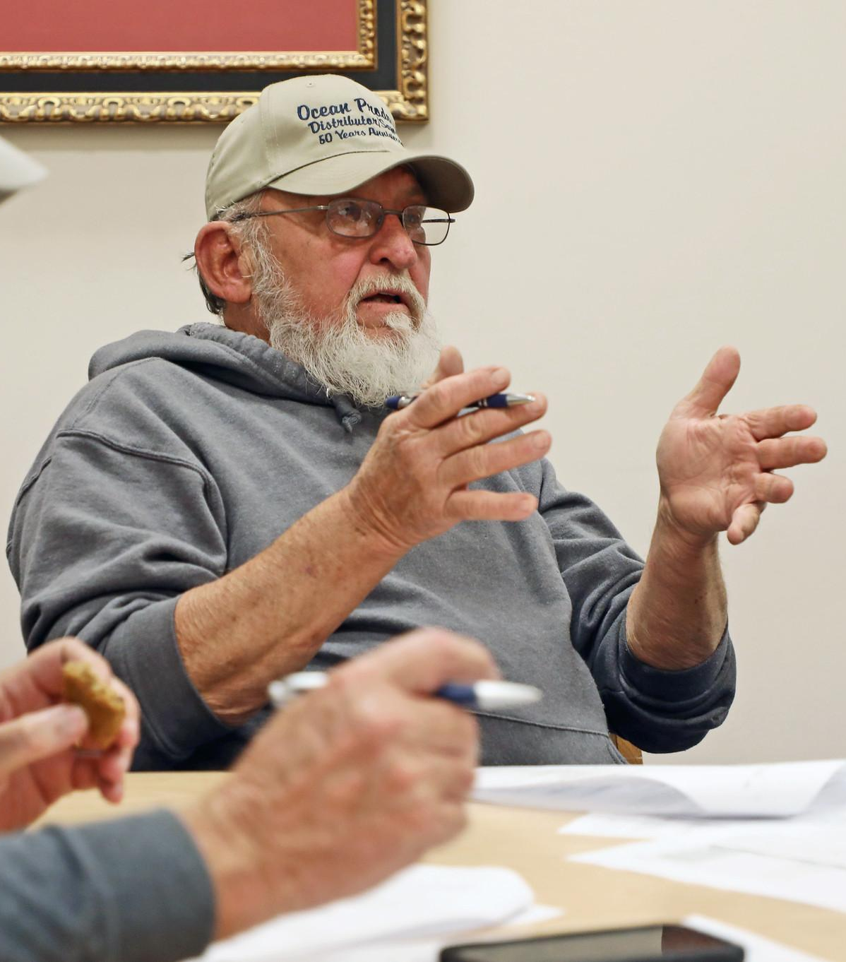
PART 3
Making Your Voice Heard
Public comment periods are your chance to influence decisions that affect your livelihood. There's a right way to do it.

Slide 9
Make Your Point - One Point
Most public comment periods give you 1-2 minutes. Make them count.
The Formula
What Works
Share information regulators don't have
Explain how it affects you specifically
Stay calm and professional
1. State your name and stake
"I'm [name], a commercial fisherman out of [location]."
2. State your one point
What's the ONE thing you want them to remember?
3. Back it up
What Doesn't
One specific example
Personal attacks
Rambling without a clear point
Reading your whole life story
4. Make the ask
What do you want them to do? Be specific.

Slide 10
HANDS-ON ACTIVITY
Mock Public Comment
The Scenario
There is a meeting considering the bushel limit being reduced. You have 30 seconds to make your case.

Slide 11
Key Takeaways
Understand your brand
1
Know what your business is about and be mindful of how you present yourself.
Know your audience
2
Different people want different things. Change your communication depending on who you’re talking to.
Making the media work for you
3
In interviews, you are in control. Take advantage of the publicity.
Show up and speak up
4
Make one clear point. Coordinate with others.

Slide 12

Questions?
Joe Caterine
jwcaterine@vims.edu

